Slide 1
WEL - COME

Slide 2
ARTIFICIAL INTELLIGENCE
^{PRESENTED BY}
^{Anushka}
^{ranaware}

Slide 3
What is AI……?
Artificial intelligence is the science of making machines that can think like humans. It can do things that are considered "smart." AI technology can process large amounts of data in ways, unlike humans. The goal for AI is to be able to do things such as recognize patterns, make decisions, and judge like humans

Slide 4
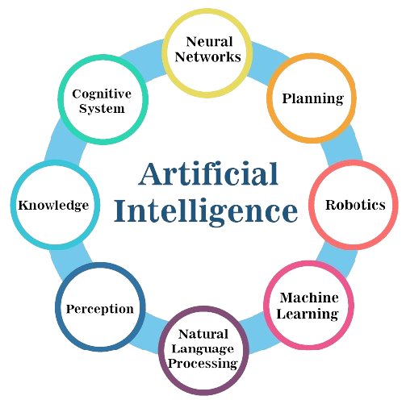

Slide 5
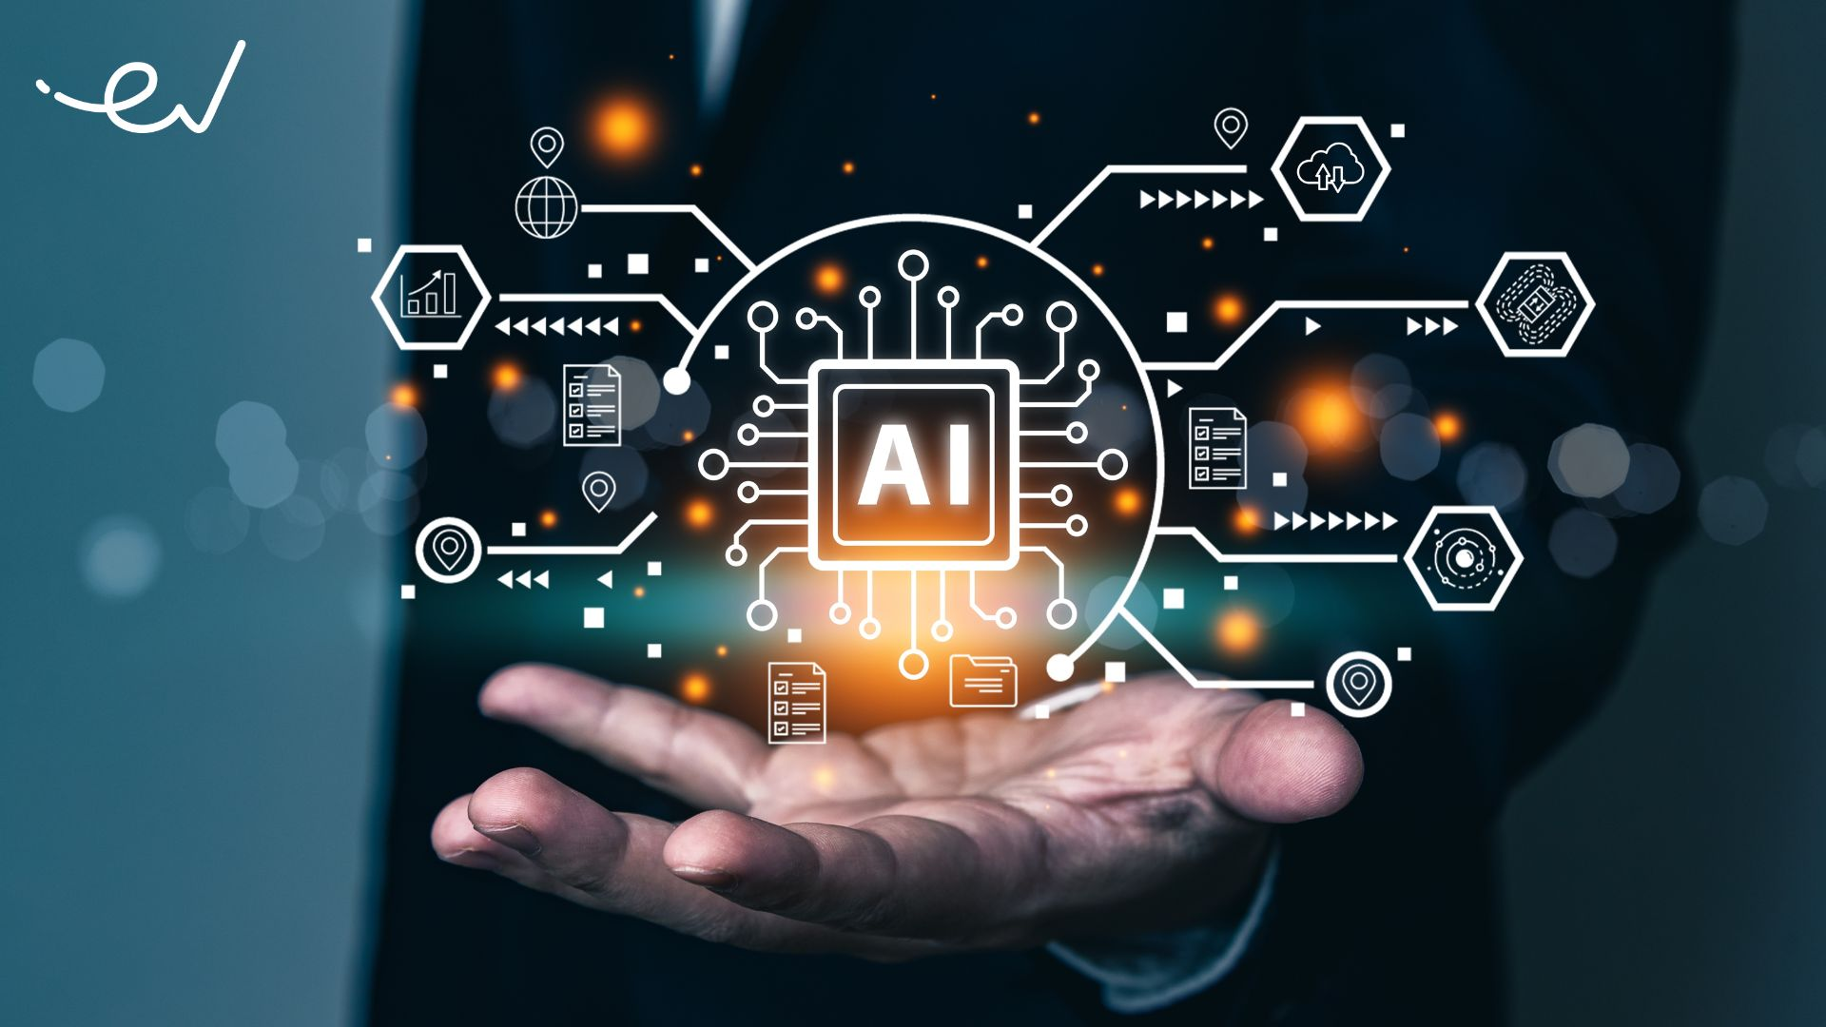

Slide 6
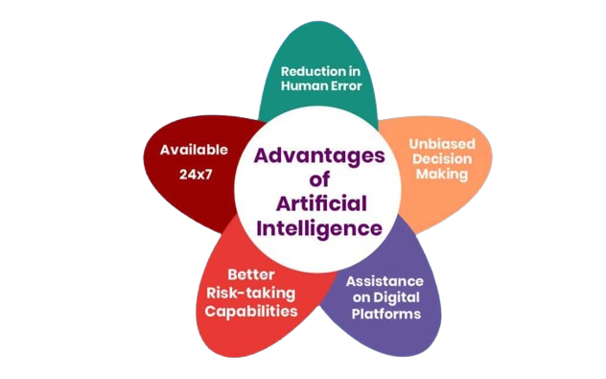

Slide 7
WHY AI IS SO IMPORTANT…?
Artificial intelligence (AI) makes it possible for machines to learn from experience, adjust to new inputs and perform human-like tasks.

Slide 8
HOW DOES AI IS HELP US IN REAL LIFE…
AI can help automate and speed up processes within society, such as increasing efficiency in the workplace or improving decision making. Additionally, AI can help identify and solve problems that humans may not be able to see or solve on their own.

Slide 9
USE OF AI IN EDUCATION…
Some ways that AI may be used in manufacturing include: Improved efficiency: Automating tasks, such as assembly and inspection. Increased productivity: Optimizing production processes. Improved quality: AI can be used to detect defects and improve quality control.

Slide 10
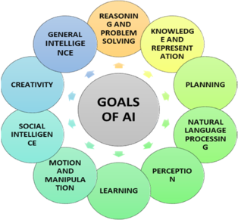

Slide 11
Purpose of ai
the goal of AI is to provide software that can reason on input and explain on output.

Slide 12
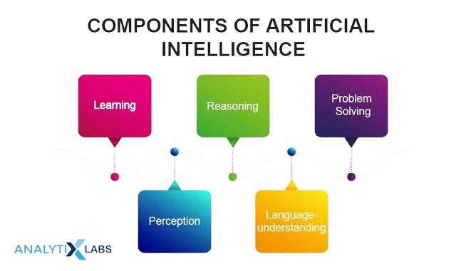

Slide 13
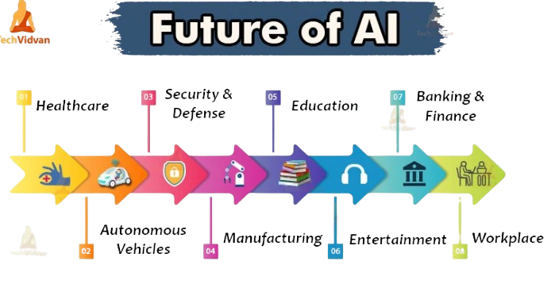

Slide 14


